Slide 1
THE EFFECT OF SUNLIGHT EXPOSURE IN MICROBIAL QUALITY STANDARDS IN BOTTLED DRINKING WATER UNDER AMBIENT ENVIRONMENTAL CONDITIONS IN COLOMBO DIVISIONAL SECRETARAIT
Fathima Rukaiya Safeer
Matrix Number: 072019070002
Faculty of Life and Health Sciences
Management & Science Institute (MSI) , Colombo

Slide 2
Contents:
Chapter 1 - Introduction
Chapter 2 - Research Methodology
References

Slide 3
Chapter 1 - Introduction
Background Information
Justification
Research Objectives
Significance of the study
Limitation of the study

Slide 4
Chapter 1 - Introduction
Background Information
Diseases caused due to unhygienic water is a prime health topics worldwide (Shams et al., 2019)
Consumption of bottled water continues to increase steadily as a result of public concerns about microbial and chemical contaminants in tap water (Venkatesan, Balaji and Victor 2014)
Consumption of bottled water has increased 200% in the past decade and projected to increase demand by 30% in the next 5 years(Penland and Wilhelmus 1999).
Severe guidelines have been enforced to regulate the quality of bottled water in several countries because it has become prominent throughout the world (WHO 2002)

Slide 5
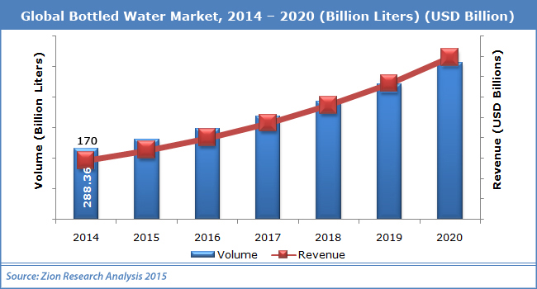
Source: https://www.marketresearchstore.com/report/bottled-water-market-z39681

Slide 6
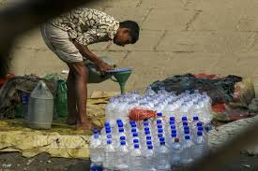
In Sri Lanka
Use of bottled water has been increasing over the last decade (Sasikaran et al., 2012)
The Public Health Division of the Ministry of Health, Sri Lanka 2019, registers 181 packaged drinking water brands
Packaged and natural mineral water producers get a verification of registration from the Food Authority of Sri Lanka, to either produce or import bottled drinking water (Herath et al. 2012)
Because of expanded interest, there is a theory that
numerous unlawfully packed brands are present in
the market (Sasikaran et al., 2012)

Slide 7
Chapter 1 - Introduction
Justification
Continually rising usage of bottled water and consumer’s belief that they are of high quality shows the need to emphasize on this topic
Manufacturers' adherence to bottled water regulations is questionable, raising concerns regarding the quality of bottled water in the country
In a previous study conducted in Sri Lanka eighty percent of brands showed higher heterotrophic plate counts (HPC) which exceeded the WHO guidelines for bottled drinking water (Herath et al., 2012)

Slide 8
Chapter 1 - Introduction
Significance
The outcomes of this research on bottled water quality allows an enhanced understanding of the situation which is damaging the nature of bottled water and are valuable data for consumers
It will likewise give a strong basis by which modifications of guidelines administering bottled water quality can be based
The continually rising usage of bottled water and consumer’s belief that they are of high quality shows the need to emphasize on this topic

Slide 9
Chapter 1 - Introduction
Limitations
Selected only 60 total samples and 5 brands
Identification is not up to species level
Only within the Colombo Divisional Secretariat area

Slide 10
Chapter 1 - Introduction
Objectives
General Objective
To assess the effect of sunlight exposure in microbial quality standards of bottled water distributed in Colombo Divisional Secretariat under ambient environmental conditions
Specific Objective
To assess types of algae present in bottled water exposed to sunlight
To assess the bacterial species present in bottled water exposed to sunlight
To determine the average number of viable colony counts for bacteria isolated from each brand of bottled water

Slide 11
Chapter 2 - Research Methodology
Materials and Methods
Study Design
A descriptive cross-sectional study design
Sample Selection
Simple random sampling - 5 supermarkets and convenience stores will be chosen to do the survey
Study Setting
Water bottle will be purchased from selected manufacturers located within the boundaries of Colombo divisional secretariat

Slide 12
Materials & methods Cont.
Study Period
August 2019 until May 2020
Sample Size
Sample size - 60 (due to the practical feasibility of the research)
Sampling Technique
Simple Random Sampling - to specify the brands for the study

Slide 13
Materials & methods Cont.
Sampling Implementation
Collection of Sample
4 different batches of 5 different brands will be collected once in 2 weeks for 2 months directly from the manufacturing company
3 bottles will be purchased each collection time

Slide 14
Materials & methods Cont.
Sample Preparation
Control batch – the first batch of samples and will be analysed immediately after collection
Second batch will be tested after 14 days :
exposed to sunlight for 9 hours per day between 8 a.m. to 5 p.m.
samples will not be exposed to sunlight

Slide 15
Methodology Cont.
Bacterial Assessment
49.53 g of MacConkey medium will be suspended into 1000 ml distilled water and heated
sterilize by autoclaving at 15 lbs pressure (121 °C) for 15 minutes and then cooled to 45-50 °C
sample will be serially diluted (10 folds) using 9 ml of sterile distilled water against 1ml of the sample
19 ml of already prepared MacConkey will be poured into the petri-dishes, and incubated at 35 °C for 24 h
Colonies of agar plates will be counted and expressed as colony forming units per mL (cfuml⁻¹)

Slide 16
Methodology Cont.
Algal Assessment
65g of sabouraud dextrose agar (SDA) will be suspended into 1000 ml distilled water and heated
sterilize by autoclaving at 15 lbs pressure (121 °C) for 15 minutes and then cooled to 45-50 °C
sample will be serially diluted (10 folds) using 9 ml of sterile distilled water against 1ml of the sample
19 ml of prepared SDA will be poured into the petri-dishes, and incubated at 25-35 °C and examined twice a week, for 4-6 weeks
Colonies of SDA will be counted and expressed as colony forming units per mL (cfuml⁻¹)

Slide 17
Materials & methods Cont.
Isolation and Identification
Test for Algal Assessment
The colonial and morphological features of the fungal colonies will be elucidated using the compound microscope.
Test for Bacterial Assessment
Colony morphology
Gram stain

Slide 18
Materials & methods Cont.
Data Analysis
SPSS statistics software will be used for data processing and analysis
Chi square and t-test will be used to compare means of the number of viable colony counts in water samples with and without sun light exposure.

Slide 19
References
Herath, A., Abayasekara, C., Chandrajith, R. and Adikaram, N. (2012). Temporal Variation of Microbiological and Chemical Quality of Noncarbonated Bottled Drinking Water Sold in Sri Lanka. Journal of Food Science, 77(3), pp.M160-M164. DOI: 10.1111/j.1750-3841.2011.02588.x [Accessed: 11th September 2019].
Penland, R. L and Wilhelmus, K. R. (1999). Microbiologic analysis of bottled water: is it safe for use with contact lenses? Ophthalmology 106:1500–03. DOI: 10.1016/s0161-6420(99)90443-8 [Accessed: 11th September 2019].
Sasikaran, S., Sritharan, K., Balakumar, S. and Arasaratnam, V. (2012). Physical, chemical and microbial analysis of bottled drinking water. Ceylon Medical Journal, 57(3), p.111. DOI: 10.4038/cmj.v57i3.4149 [Accessed: 26th September 2019].
Shams, M., Qasemi, M., Afsharnia, M., Mohammadzadeh, A. and Zarei, A. (2019). Chemical and microbial quality of bottled drinking water in Gonabad city, Iran: Effect of time and storage conditions on microbial quality of bottled waters. MethodsX, 6, pp.273-277. DOI: 10.1016/j.mex.2019.02.001 [Acessed: 26th September 2019].
Venkatesan, K., Balaji, M., and Victor, K. (2014). Microbiological analysis of packaged drinking water sold in Chennai. International Journal of Medical Science and Public Health, 3(4), p.472. DOI: 10.5455/ijmsph.2014.150220143 [Accessed: 11th September 2019].
WHO. (2002). Guidelines for drinking water quality. 2nd edn. Vol 1: Microbiological methods. Geneva: World Health Organization [Accessed: 11th September 2019].

Slide 20
Thank You

